Slide 1
Introduction to Data Analysis

Slide 2
DATA INSIGHT FUNDAMENTALS
Patrick Boily Data Action Lab | uOttawa | Idlewyld Analytics
pboily@uottawa.ca
[with files from Jen Schellinck | Sysabee]

Slide 3
“Reports that say that something hasn't happened are always interesting to me, because as we know, there are known knowns; there are things we know that we know. There are known unknowns; that is to say, there are things that we now know we don't know. But there are also unknown unknowns – there are things we do not know we don't know.”
Donald Rumsfeld, US Department of Defense News Briefing, 2002

Slide 4
ANALYSIS PLANNING
DATA INSIGHT FUNDAMENTALS
“Plans are nothing. Planning is everything.”
Dwight D. Eisenhower

Slide 5
ANALYSIS PLAN OVERVIEW
[CDC, Creating an Analysis Plan]
Formulate research questions/hypotheses
Identify necessary (and available) datasets
Establish inclusion/exclusion criteria for records/observations
Select variables for use in the analyses
Chose statistical methods and software

Slide 6
DATA 101: BASIC DATA CONCEPTS
DATA INSIGHT FUNDAMENTALS
“You can have data without information, but you cannot have information without data.”
Daniel Keys Moran (attributed)

Slide 7
WHAT IS DATA?
4,529 ‘red’ 25.782 ‘Y’

Slide 8
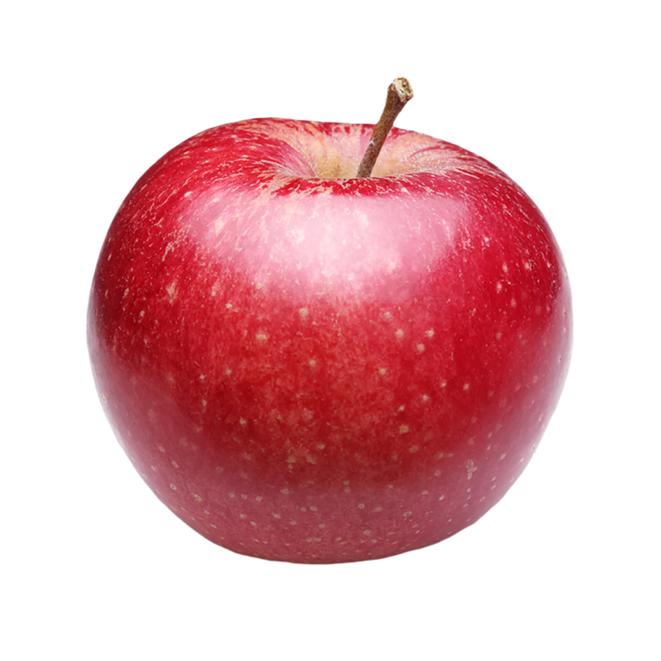
OBJECTS AND ATTRIBUTES
Object: apple
Shape: spherical
Colour: red
Function: food
Location: fridge
Owner: Jen
Remember: a person or an object is not simply the sum of its attributes!

Slide 9
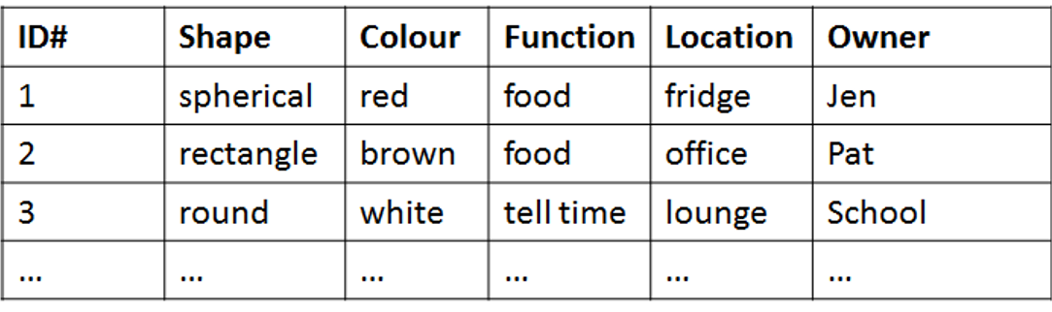
FROM ATTRIBUTES TO DATASETS
Attributes are fields (columns) in a database; objects are instances (rows).
Objects are described by their feature vector, the collection of attributes associated with value(s) of interest.

Slide 10
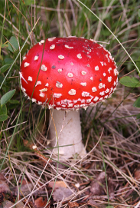
POISONOUS MUSHROOM DATASET
[https://archive.ics.uci.edu/ml/datasets/Mushroom]
Amanita muscaria
Habitat: woods Gill Size: narrow Odor: none Spores: white Cap Colour: red
Classification problem: Is Amanita muscaria edible, or poisonous?

Slide 11
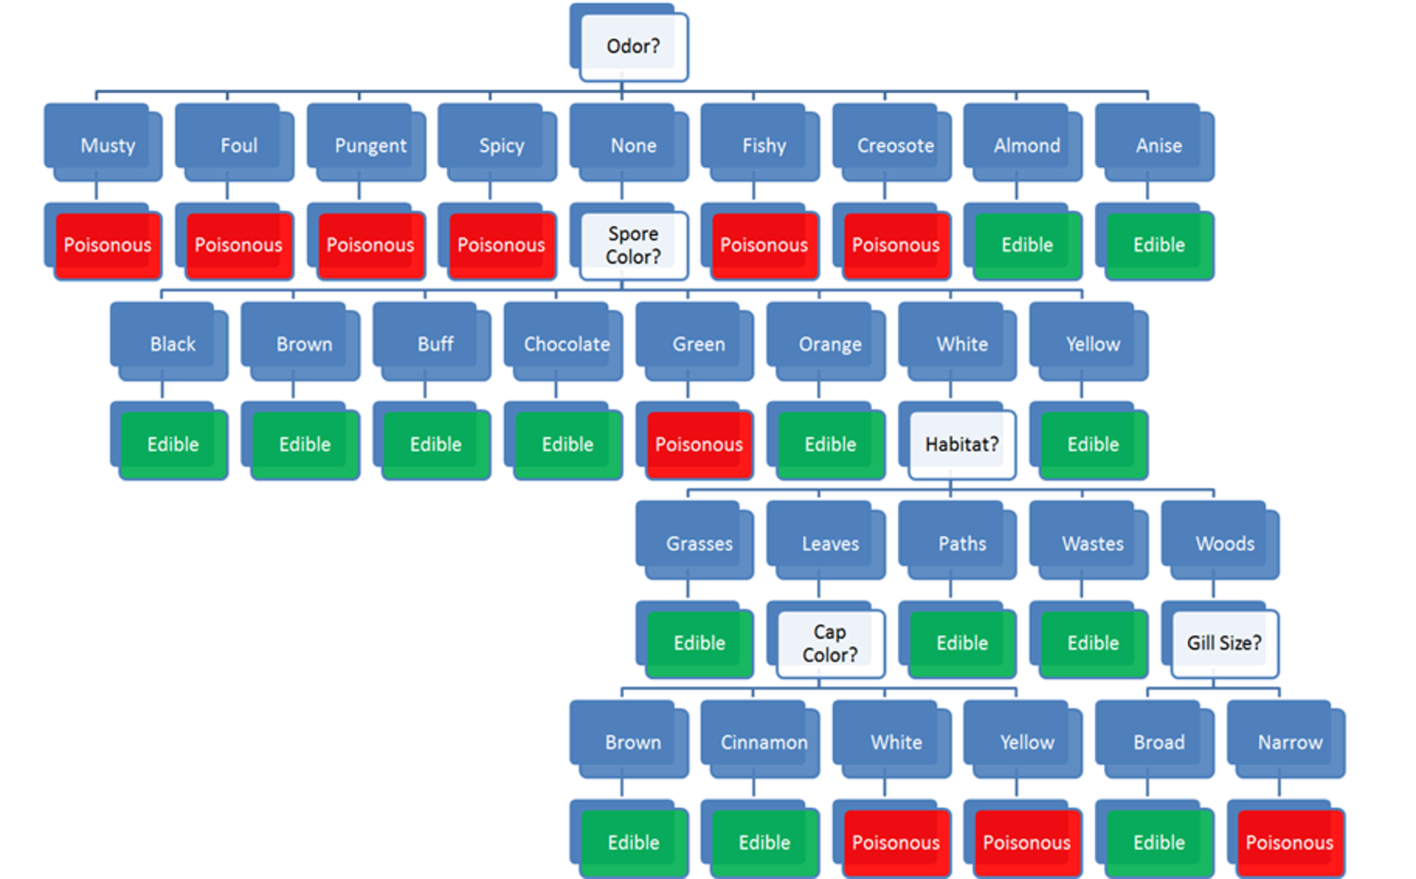
Habitat: woods
Gill Size: narrow
Odor: none
Spores: white
Cap Colour: red
Classification problem: edible or poisonous?

Slide 12
Habitat: woods
Gill Size: narrow
Odor: none
Spores: white
Cap Colour: red
Classification problem: edible or poisonous?

Slide 13
Habitat: woods
Gill Size: narrow
Odor: none
Spores: white
Cap Colour: red
Classification problem: edible or poisonous?

Slide 14
Habitat: woods
Gill Size: narrow
Odor: none
Spores: white
Cap Colour: red
Classification problem: edible or poisonous?

Slide 15
Habitat: woods
Gill Size: narrow
Odor: none
Spores: white
Cap Colour: red
Classification problem: edible or poisonous?

Slide 16
Habitat: woods
Gill Size: narrow
Odor: none
Spores: white
Cap Colour: red
Classification problem: edible or poisonous

Slide 17
DISCUSSION
Would you have trusted an “edible” prediction?
Where is the model coming from?
What would you need to know to trust the model?
What’s the cost of making a classification mistake, in this case?

Slide 18
ASKING THE RIGHT QUESTIONS
Data science is really about asking and answering questions:
Analytics: “How many clicks did this link get?”
Data Science: “Based on this user’s previous purchasing history, can I predict what links they will click on the next time they access the site?”
Data mining/science models are usually predictive (not explanatory): they show connections, but don't reveal why these exist.
Warning: not every situation calls for data science, artificial intelligence, machine learning, statistics, or analytics.

Slide 19
THE WRONG QUESTIONS
Too often, analysts are asking the wrong questions:
questions that are too broad or too narrow
questions that no amount of data could ever answer
questions for which data cannot reasonably be obtained
The best-case scenario is that stakeholders will recognize the answers as irrelevant.
The worst-case scenario is that they will erroneously implement policies or make decisions based on answers that have not been identified as misleading and/or useless.

Slide 20
DATA SCIENCE/MACHINE LEARNING/ AUGMENTED INTELLIGENCE TASKS
Classification and class probability estimation: which clients are likely to be repeat customers?
Clustering: do diplomatic missions form natural groups?
Association rule discovery: what books are commonly purchased together?
Others:
profiling and behaviour description; link prediction; value estimation (how much is a client likely to spend in a restaurant); similarity matching (which prospective clients are similar to a company's best clients?); data reduction; influence/causal modeling, etc.

Slide 21
*CLASSIFICATION
Classifier: if presented with an object, can we classify it into one of several predefined categories?
There are many different techniques that carry out classification, but the general steps are the same:
Use a training set to teach the classifier how to classify.
Test/validate the classifier using new data
Use the classifier to classify novel instances
Some classifiers (e.g. neural nets) are ‘black box’ models. They do a good job, but we don’t know what is happening!

Slide 22
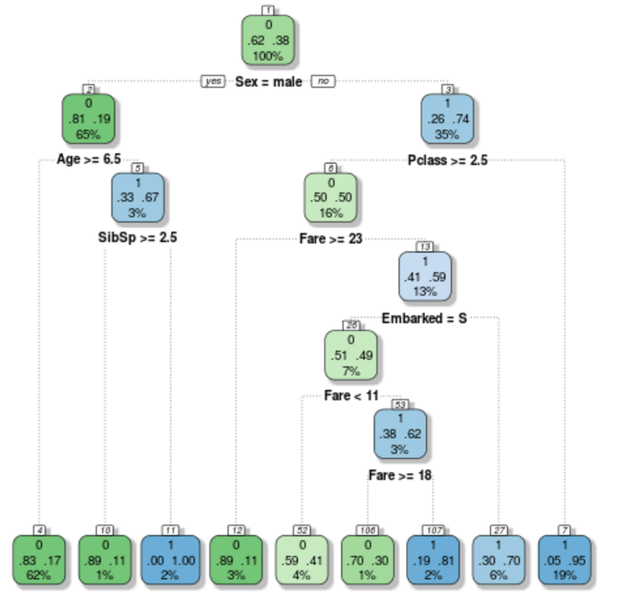
*DECISION TREE CLASSIFIERS
Decision tree: methodically use the available information to classify observations.
These trees are built automatically (statistical learning).
Once built, it is easy to see how the tree makes classification decisions (white box model).

Slide 23
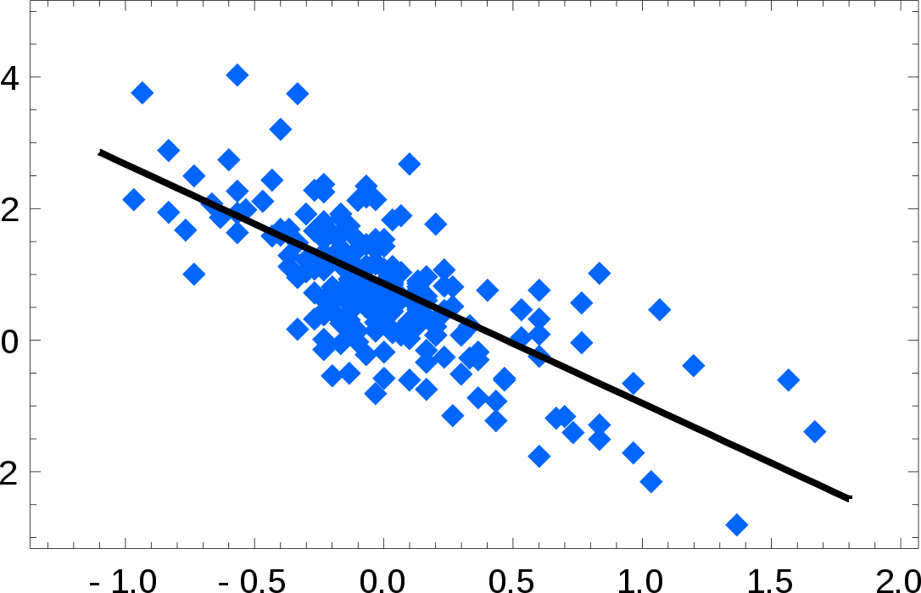
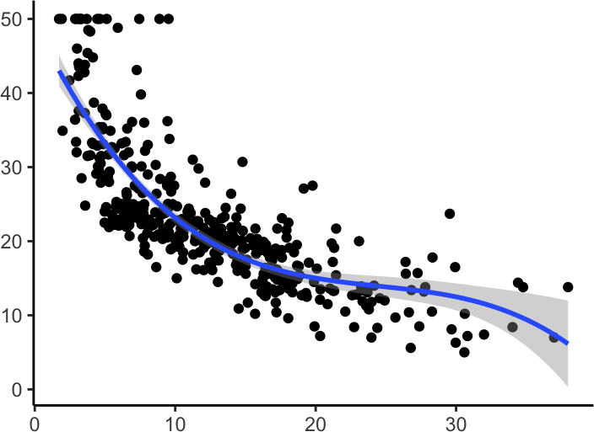
*REGRESSION ANALYSIS
If presented with an object, can we predict the value of its response variables?
There are many different techniques to do so, and the methods are somewhat similar (but don’t always use the same framework):
traditional approaches (linear, non-linear, trees, etc.)
training/testing/validating approaches
As was the case for classification, some regression models are ‘black boxes’.
Quarterly change in GDP (%)
Quarterly change in unemployment rate (%)

Slide 24
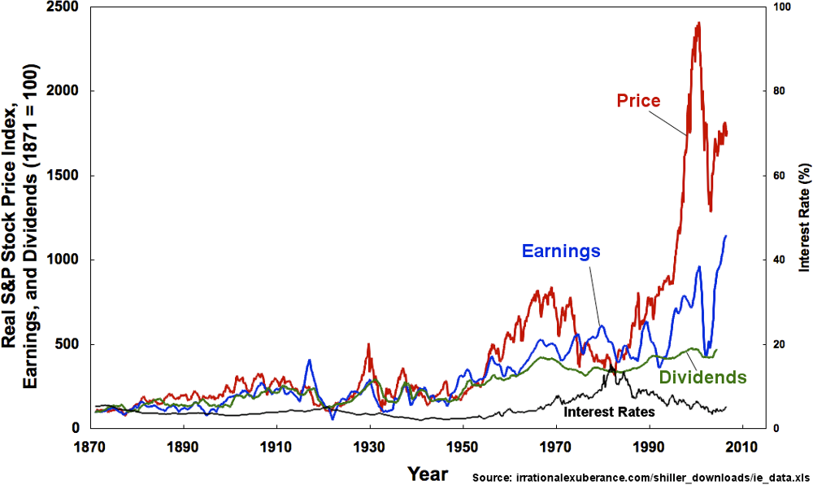
*TIME SERIES ANALYSIS
A simple time series has two variables: time + 2nd variable.
What is the pattern of behaviour of this second variable over time? Relative to other variables?
Can we use this information to forecast the behaviour of the variable in the future?

Slide 25
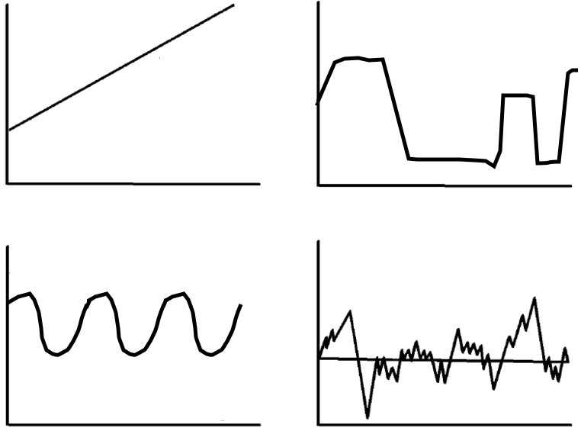
*TEMPORAL PATTERNS
The goals are familiar:
find patterns in the data
create a mathematical model that captures the essence of these patterns
The patterns can be quite complex – some fancy analysis typically required!
The overall series can often be broken down into multiple component models.

Slide 26
*SUPERVISED/UNSUPERVISED LEARNING
Automated behaviours vs intelligent behaviours
Supervised: examples are given (training set), algorithm learns from those
Unsupervised: learning happens based on what is seen in the data
Unsupervised techniques:
association rules
recommender engines
novel categories (clustering)

Slide 27

*ANOMALY DETECTION
An anomaly is an unexpected, unusual, atypical, or statistically unlikely event.
A fair number of data analysis pipeline are built in order to alert users when things are out of the ordinary.
Analytical approaches include:
supervised (classification), unsupervised (clustering)
association rules deviation
ensemble techniques
directed

Slide 28
SOME PRACTICAL DEFINITIONS
DATA INSIGHT FUNDAMENTALS
“What’s in a name? That which we call a rose By any other name would smell as sweet.”
W. Shakespeare, Romeo and Juliet, Act II, Scene 2

Slide 29
WHAT IS DATA ANALYSIS?
Finding patterns in data
Using data to do something (answer a question, assist in decision-making, predict a future occurrence, draw a conclusion)
Creating models of the data
Describing or explaining a situation (the system)
(Testing (scientific) hypotheses?)
(Carrying out calculations on data?)

Slide 30
WHAT IS DATA SCIENCE?
Data science is the collection of processes by which we extract useful and actionable insights from data.
T. Kwartler (paraphrased)
Data science is the working intersection of statistics, engineering, computer science, domain expertise, and “hacking.” It involves two main thrusts: analytics (counting things) and inventing new techniques to draw insights from data.
H. Mason (paraphrased)

Slide 31
WHAT IS MACHINE LEARNING?
Starting around the 1940s, researchers began the earnest study of how to teach machines to learn.
The goal of machine learning was (is?) to create machines that can learn, adapt, and respond to novel situations
A wide variety of techniques, accompanied by a great deal of theoretical underpinning, was created to achieve this goal.

Slide 32
WHAT IS ARTIFICIAL/AUGMENTED INTELLIGENCE?
Artificial Intelligence (A.I.) is non-human intelligence that has been engineered rather than one that has evolved naturally.
A.I. research is research carried out in pursuit of this goal.
Pragmatically speaking, A.I. is “computers carrying out tasks that only humans can usually do”.
Augmented Intelligence is human intelligence that is supported or enhanced by machine intelligence.

Slide 33
WORKFLOWS and Pipelines
DATA INSIGHT FUNDAMENTALS
“All models are wrong. Some models are useful.”
George Box

Slide 34
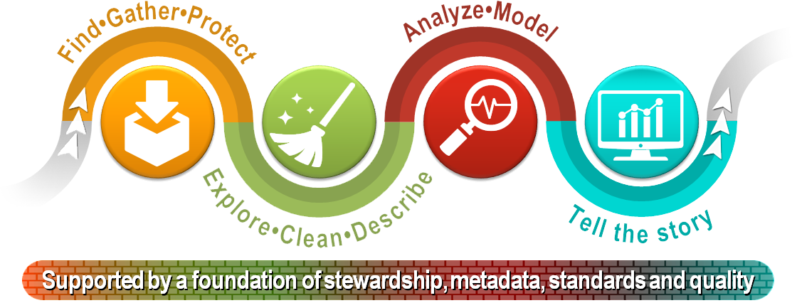
[StatCan, Steps of the Data Journey]

Slide 35
THE DATA SCIENCE WORKFLOW
Objective/
Rationale
Utilization and Decision Support
Data Collection
Data Exploration
Infrastructure and Data Management
Data Preparation
Modeling and Analysis
Communication

Slide 36
THE DATA SCIENCE WORKFLOW
Objective/
Rationale
Utilization and Decision Support
Data Collection
Data Exploration
Infrastructure and Data Management
Data Preparation
Modeling and Analysis
Communication

Slide 37
THE DATA ANALYSIS PROCESS
A large number of analytical models have to be generated before a final selection can be made.
Iterative process: feature selection and data reduction may require numerous visits to domain experts before models start yielding promising results.
Domain-specific knowledge has to be integrated in the models in order to beat random classifiers and clustering schemes, on average.

Slide 38
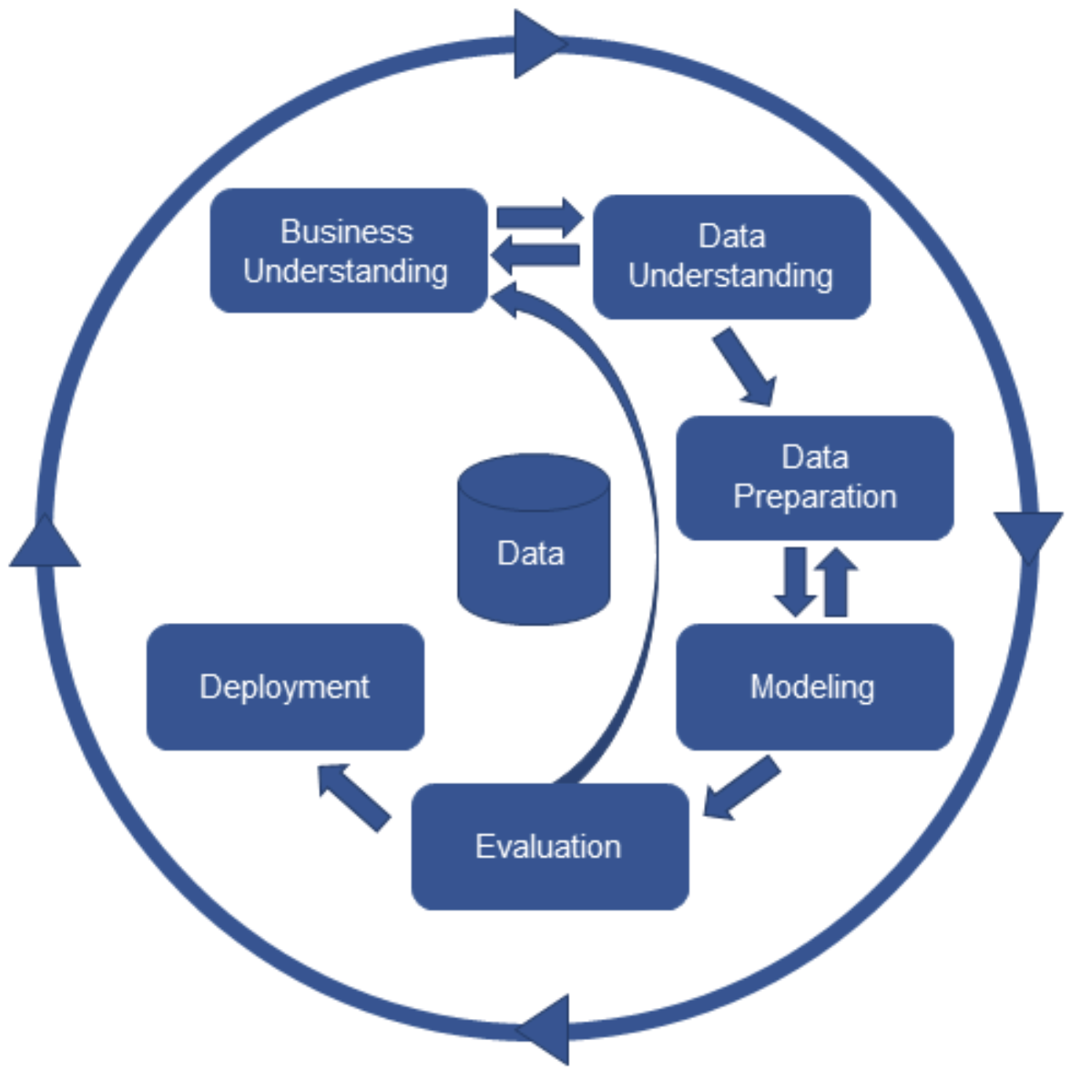
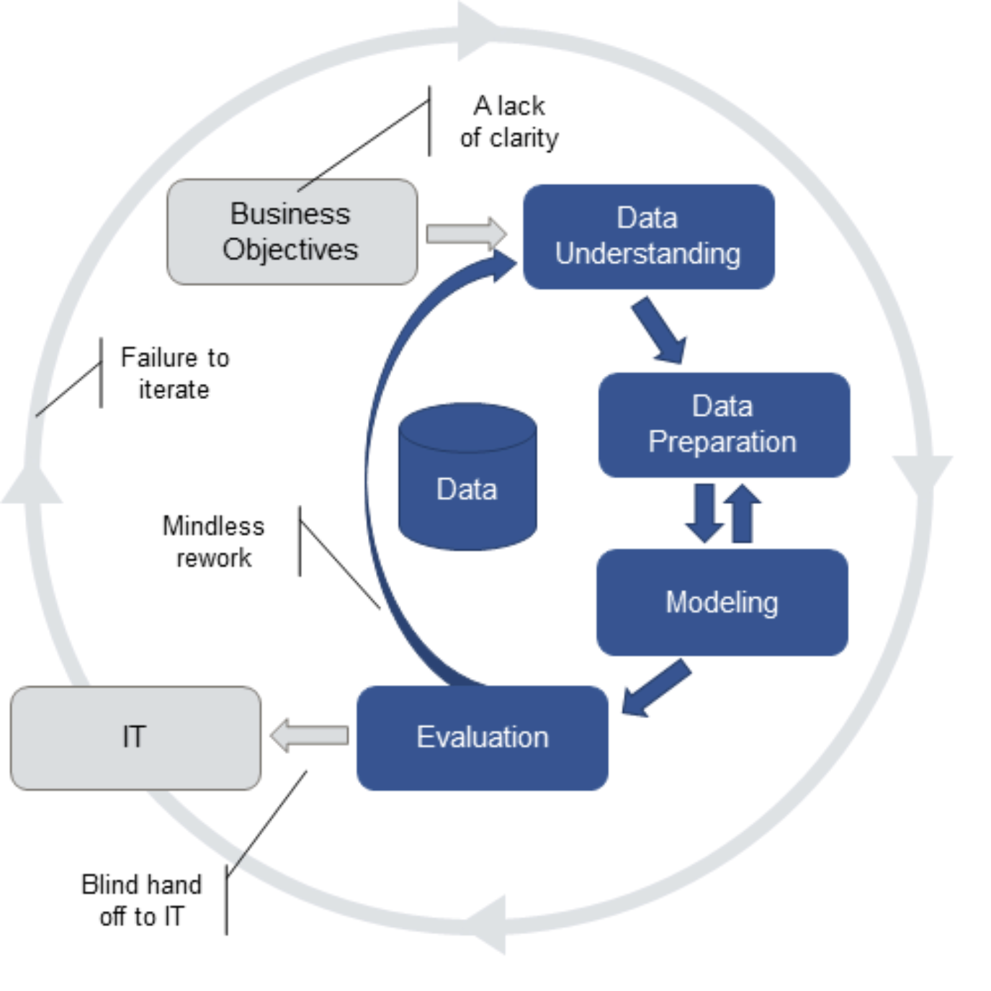
**CROSS INDUSTRY STANDARD PROCESS DATA MINING (CRISP-DM)
[James Taylor]
Notes:
https://itsalocke.com/crisp-dm/

Slide 39
LIFE AFTER ANALYSIS
When an analysis or model is ‘released into the wild’, it can take on a life of its own.
Analysts may eventually have to relinquish control over dissemination. Results may be misappropriated, misunderstood, or shelved. What can the analyst do to prevent this?
Finally, because of analytic decay, it’s important to view the last analytical step NOT as a static dead end, but rather as an invitation to return to the beginning of the process.

Slide 40
DATA SCIENCE ECOSYSTEM
Data analysis is a team sport, with team members needing a good understanding of both data and context
data management
data preparation
analysis
communications
Even slight improvements over a current approach can find a useful place in an organization – data science is not solely about Big Data and disruption!

Slide 41
*MODEL ASSESSMENT AND VALIDITY
Models should be current, useful, and valid.
Data can be used in conjunction with existing models to come to some conclusions or can be used to update the model itself.
At what point does one determine that the current data model is out-of-date or is not useful anymore?
Past successes can lead to reluctance to re-assess/re-evaluate a model.

Slide 42
MODELS AND SYSTEMS THINKING
DATA INSIGHT FUNDAMENTALS
“What if the only valid model of the Universe is the Universe itself?”
Unknown

Slide 43
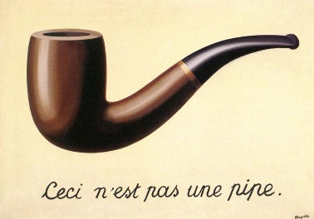
REPRESENTATIONS
A representation is an object that stands in for another object.
A representation may or may not physically resemble the object it represents.
Representations of the world help us to understand, navigate, and manipulate the world.

Slide 44
[J. Schellinck]

Slide 45
THINKING IN SYSTEMS TERMS
In order to understand how various aspects of the World interact with one another, we need to carve out chunks corresponding to the aspects and define their boundaries.
Working with other intelligences requires shared understanding of what is being studied.
A system is made up of objects with properties that potentially change over time. Within the system we perceive actions and evolving properties leading us to think in terms of processes.

Slide 46
THINKING IN SYSTEMS TERMS
Objects themselves have various properties. Natural processes generate (or destroy) objects and may change the properties of these objects over time.
We observe, quantify, and record particular values of these properties at particular points in time.
This generates data points, capturing the underlying reality to some degree of accuracy and error (biased or unbiased).

Slide 47
IDENTIFYING GAPS IN KNOWLEDGE
A gap in knowledge is identified when we realize that what we thought we knew about a system proves incomplete (or false).
This might happen repeatedly, at any moment in the process:
data cleaning
data consolidation
data analysis
The solution is to be flexible. When faced with such a gap, go back, ask questions, and modify the system representation.

Slide 48
CONCEPTUAL MODELING
Exercise:
an acquaintance has just set foot in your living space for the first time
you are on the phone with them but not currently at home
explain to them how to go about changing a breaker
(how would you do so if the acquaintance was visually impaired?)
Conceptual models are built using methodical investigation tools
diagrams
structured interviews
structured descriptions
etc.

Slide 49
RELATING THE DATA TO THE SYSTEM
Is the data which has been collected and analyzed going to be of any use when it comes to understanding the system?
This question can only be answered if we understand:
how the data is collected
the approximate nature of both data and system
what the data represents (observations and features)
Is the combination of system and data sufficient to understand the aspects of the world under consideration?

Slide 50
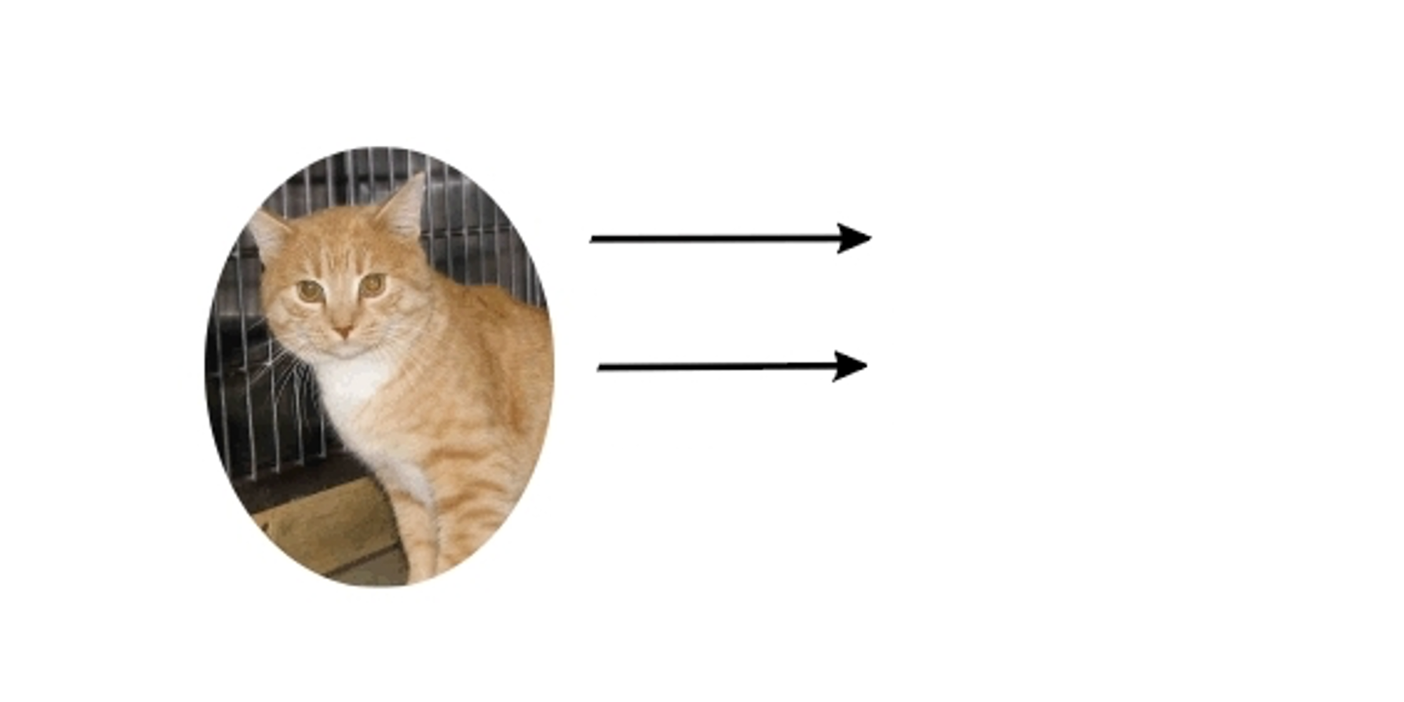
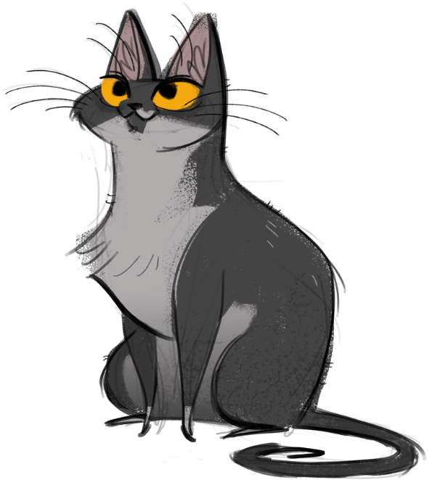
[http://dailycatdrawings.tumblr.com; #309]
Real World
Model
Theory
Identification of details relevant to description and translation of real-world objects into model variables

Slide 51
MODELS IN GENERAL
First principles modeling
examine a system
write down a set of rules/equations that describe the essence of the system
ignore complicating details that are “less” important
Statistical modeling
typically a set of equations with parameters
parameters are learned (model is “trained”) using multiple data observations
data sample vs. population

Slide 52
**MODELING HEURISTICS
In a sense, modeling is a straightforward (and formulaic?) process, guided by intuition and experience at each step.
Basic steps in building a statistical model:
defining the goals
what are we trying to achieve?
under what situations will the model be used and what is the outcome we are trying to predict?
gathering data
what data is available?
how many records will we have?
generally, modelers want as much data as possible

Slide 53
**MODELING HEURISTICS
Basic steps in building a statistical model: (continued)
deciding on the model structure
should we run a linear regression, logistic regression, or a nonlinear model? Which kind?
choices of model structure require experience and deep knowledge of the strength and weaknesses of each technique
preparing the data
assemble data into appropriate form for the model
encode the data into inputs, using expert knowledge as much as possible
separate the data into the desired training, testing, and validation sets

Slide 54
**MODELING HEURISTICS
Basic steps in building a statistical model: (continued)
selecting and removing features
variables are examined for model importance and selected or eliminated
a list of candidate appropriate variables are ordered by importance
building candidate models
begin with baseline linear models and try to improve using more complex nonlinear models
keep in mind the environment in which the model will be implemented
finalizing the model
select among the candidates the most appropriate model to be implemented
implementing and monitoring
embed the model into necessary system process; implement monitoring steps to examine the model performance

Slide 55
**MODELING PITFALLS
Common pitfalls surrounding the modeling process:
defining the goals
lack of clarity around problem definition
lack of understanding of how and where the model will be used
gathering data
using data that is too old or otherwise not relevant going forward
not considering additional key data sources or data sets that might be available
deciding on the model structure
using a modeling methodology that is not appropriate for the nature of the data (sizes, dimensions, noise…)

Slide 56
**MODELING PITFALLS
Common pitfalls surrounding the modeling process: (continued)
preparing the data
not cleaning or considering outliers
not properly scaling data
not giving enough thought to building special expert variables
not having data from important categories of records
selecting and eliminating features
keeping too many variables, making it hard for modeling, interpretation, implementation, or model maintenance
too much reliance on simply eliminating correlated variables

Slide 57
**MODELING PITFALLS
Common pitfalls surrounding the modeling process: (continued)
building candidate models
overfitting
not doing proper training/testing as one examines candidate models
not doing a simpler linear regression to use as baseline
finalizing the model
not rebuilding the final model optimally using all the appropriate data
improperly selecting the final model without consideration to some implementation constraints
implementing and monitoring
errors in implementation process: data input streams, variable encodings, algorithm mistakes
not monitoring model performance

Slide 58
TAKE-AWAYS
Systems can approximate certain aspects of the Universe.
System models provide the basis under which data is identified and collected, but data itself is approximate and selective.
Knowledge gaps happen – be ready to re-visit your set-up regularly.
Implicit conceptual modeling can lead to problematic situations.
If the data, the system, and the world are out of alignment, data analysis insights might ultimately prove useless.

Slide 59
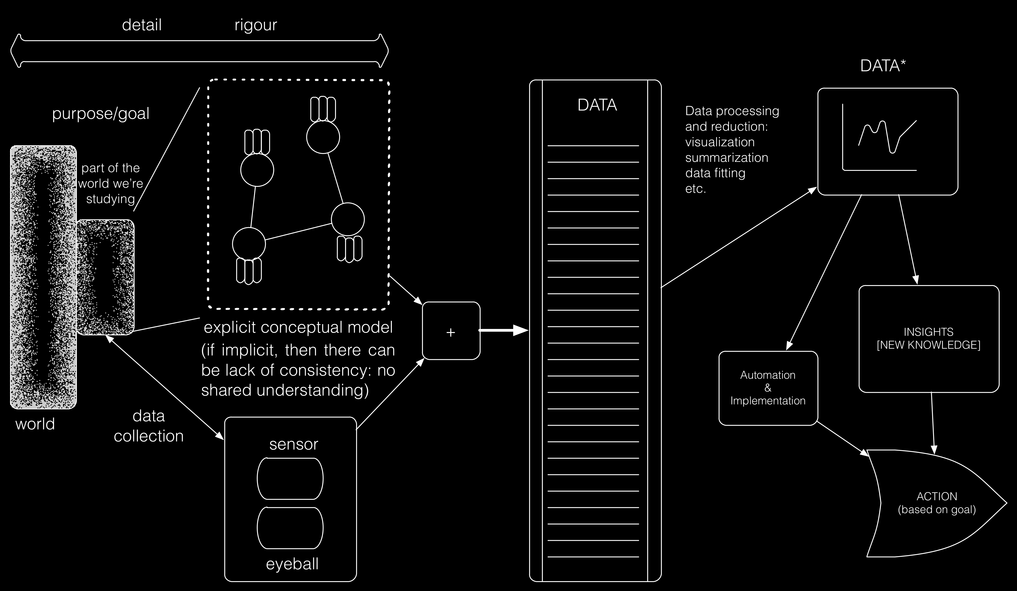
[J. Schellinck]

Slide 60
ETHICAL CONSIDERATIONS & BEST PRACTICES
DATA INSIGHT FUNDAMENTALS
“We have flown the air like birds and swum the sea like fish but have yet to learn the simple act of walking the Earth like brothers.”
Martin Luther King, Jr.

Slide 61
What harm can come from data?

Slide 62
THE NEED FOR ETHICS
Formerly: “Wild West” mentality to data collection (and use). Whatever wasn’t technologically forbidden was allowed.
Now: professional codes of conduct are being devised for data scientists (outline responsible ways to practice data science).
Additional responsibility for data scientists; but also, protection against being hired to carry out questionable analyses.
Does your organization have a code of ethics for its data scientists? For its employees?

Slide 63
WHAT ARE ETHICS?
Broadly speaking, ethics refers to the study and definition of right and wrong conducts:
“not […] social convention, religious beliefs, or laws”. (R.W. Paul, L. Elder)
Influential ethical theories:
Kant's golden rule (do onto others…), consequentialism (the ends justify the means), utilitarianism (act in order to maximize positive effect), etc.
Confucianism, Taoism, Buddhism (?), etc.
Ubuntu, Maori, etc.

Slide 64
WHAT ARE ETHICS?
[OCAP® is a registered trademark of the First Nations Information Governance Centre (FNIGC)]
First Nations Principles of OCAP®:
Ownership cultural knowledge, data, and information is owned by communities
Control communities have the right to control all aspects of research and information management that impact them
Access communities must have access to information and data about themselves no matter where it is held
Possession communities must have physical control of relevant data

Slide 65
ETHICS IN THE DATA CONTEXT
[University of Virginia, Centre for Big Data Ethics, Law, and Policy]
Data ethics questions:
Who, if anyone, owns data?
Are there limits to how data can be used?
Are there value-biases built into certain analytics?
Are there categories that should not be used in analyzing personal data?
Should some data be publicly available to all researchers?
Analytically, the general is preferred to the anecdotal, but decisions made on the basis of machine learning and A.I. (security, financial, marketing, etc.) may affect real beings in unpredictable ways.

Slide 66
BEST PRACTICES
“Do No Harm”: data collected from an individual should not be used to harm the individual.
Informed Consent:
Individuals must agree to the collection and use of their data
Individuals must have a real understanding of what they are consenting to, and of possible consequences for them and others
Respect “Privacy”: excessively hard to maintain in the age of constant trawling of the Internet for personal data.

Slide 67
BEST PRACTICES
[More information on how to consider data privacy and human rights is found in the Intranet Data Wiki.]
Keep Data Public: data should be kept public (all? most? any?).
Opt-In/Opt-Out: Informed consent requires the ability to opt out.
Anonymize Data: removal of id fields from data prior to analysis.
“Let the Data Speak”:
no cherry picking
importance of validation (more on this later)
correlation and causation (more on this later, too)
repeatability

Slide 68
GBA+
[https://www.statcan.gc.ca/eng/topics-start/gender_diversity_and_inclusion]
Gender-Based Analysis Plus is an analytical process used to assess how different gendered people may experience policies, programs and initiatives.
Example: Work interruptions and financial vulnerability, D. Messacar, R. Morrissette
If the data had not been collected and/or analyzed in a GBA+ manner, it would be harder to see how financial vulnerability affects different groups (if the analysis had looked only at age groups and gender, for example, instead of also including family composition).
Policies and events impact real people in real way, and not always in the same manner. Data analysis methods are typically used to predict and/or describe average (or central) outcomes, but it is often those who are far from the centre who are most affected.
Let’s be smart about this.

